Slide 1
IPD Sliding Average
Group Plots and ttest
Individual Plots

Slide 2
Overview of sliding average (v1) – Choices Defection = 1 Cooperation =0
Raw- 1 2 3 4 5 6 7 8 9 10 11 12 13 14 15 16
New- 1 2 3 4 5 6 7 8 9 10 11 12 13 14 15 16
NOTE: Sliding Average (v2) simply maintains rounds 1-4, begins averaging at round 5=2+3+4+5

Slide 3
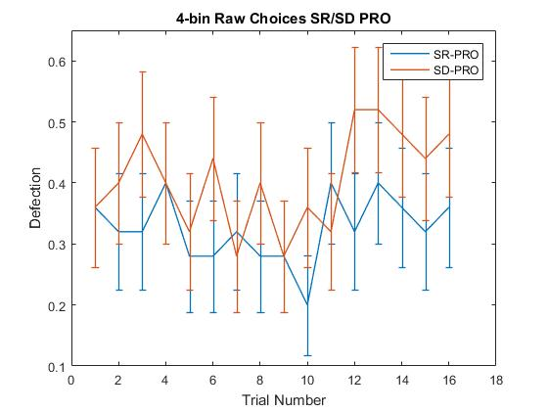
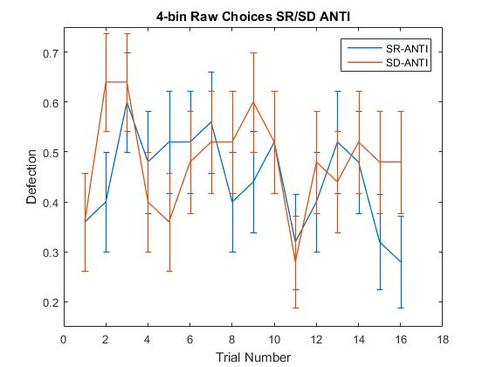
Group Raw Choices
0.17
0.08
*0.04
0.09
NOTE: Removing participants (n=3, PRO; n=2, ANTI) who purely cooperated does not change these p-values

Slide 4
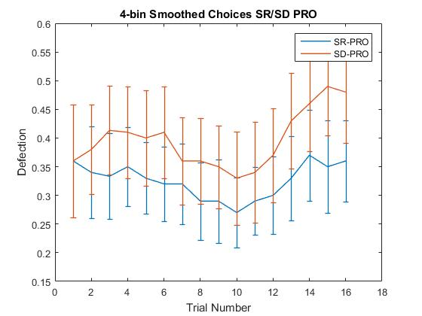
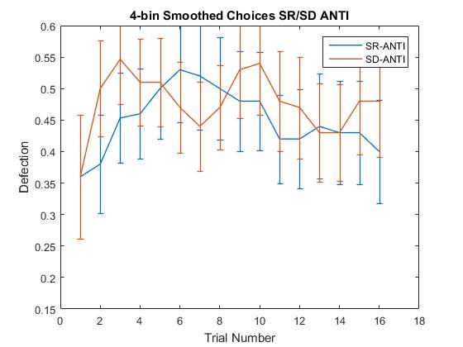
Group Smoothed Choices v1
0.13
0.07
All P > 0.27
NOTE: Removing participants (n=3, PRO; n=2, ANTI) who purely cooperated does not change these p-values

Slide 5
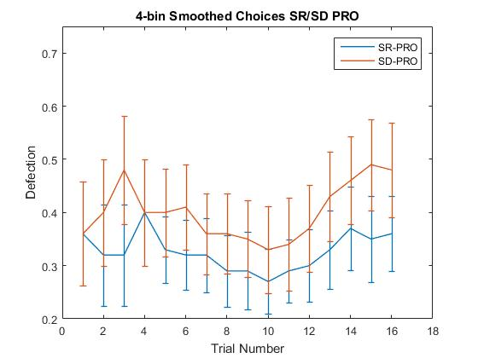
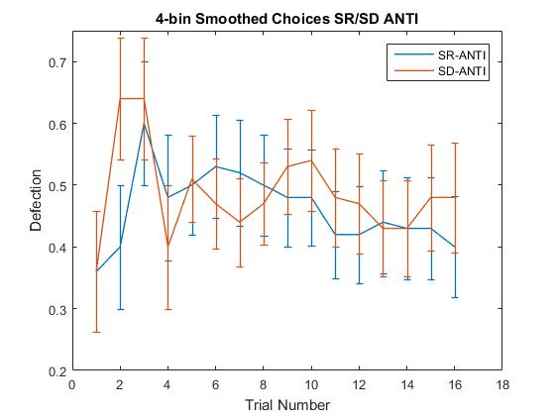
Group Smoothed Choices v2
0.08
*0.04
0.13
0.07
NOTE: Removing participants (n=3, PRO; n=2, ANTI) who purely cooperated does not change these p-values

Slide 6
Overview of sliding average - Outcomes
Same averaging procedure as choices
Average of last 4 rounds, except for first 3 rounds.
Coding (Player, Partner)**
D,C – 1 “Cheating”
D,D – 2 “Mutual Defection”
C,C – 3 “Mutual Cooperation”
C,D – 4 “Unreciprocated Cooperation”
**Another way to do this, I thought of while writing this up--Code outcomes based on PlayerChoice at round N and PartnerChoice at round n-1. That puts the player choice in context. Round 1 could potentially be set to a mean of 2.5 (?)
Coding would be same 1-4.
DC = 'Cheating';
CD='Forgiveness'

Slide 7
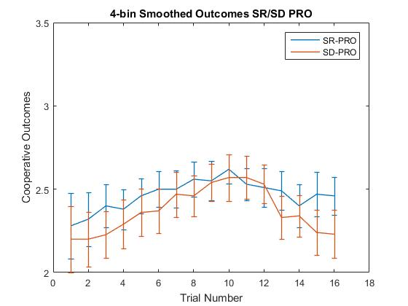
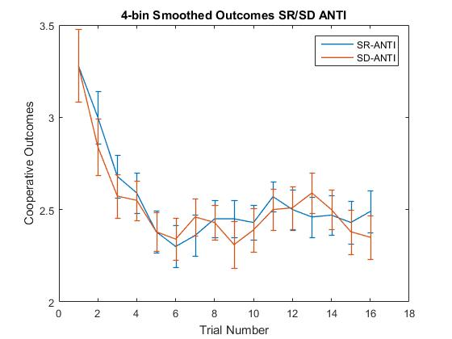
Group Smoothed Outcomes
All P > 0.23
0.10
0.12

Slide 8
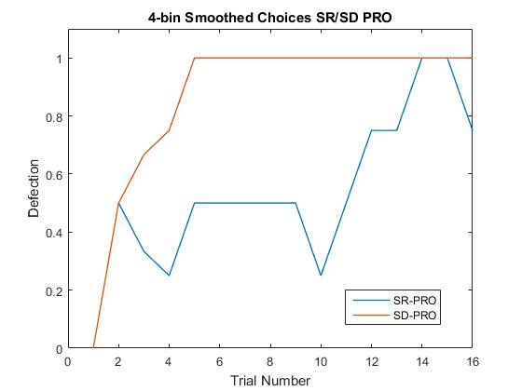
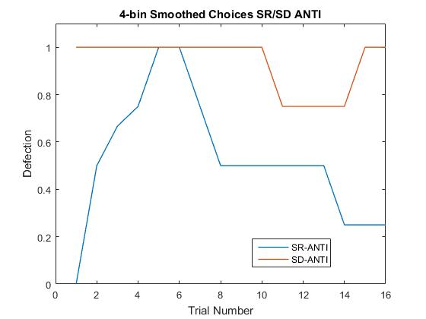
Individual Participant Choices – Smoothed 102 (v1)

Slide 9
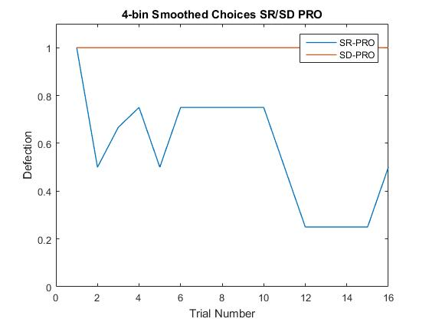
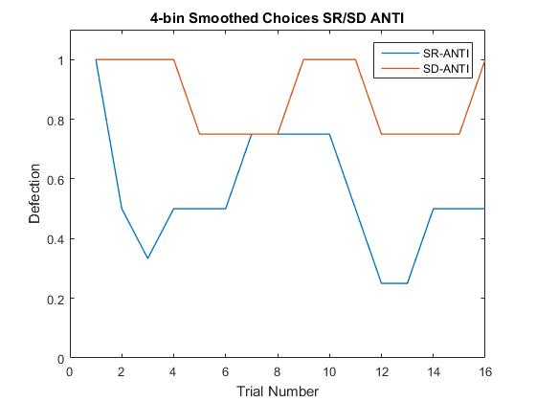
Individual Participant Choices – Smoothed 103

Slide 10
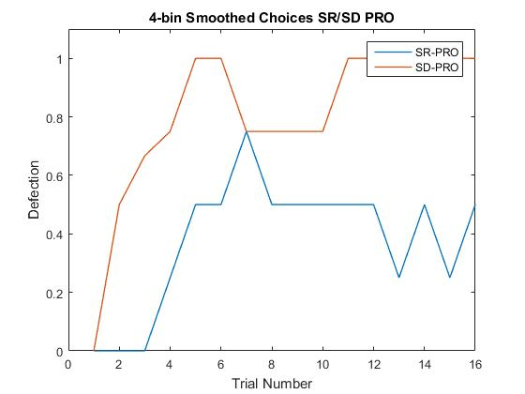
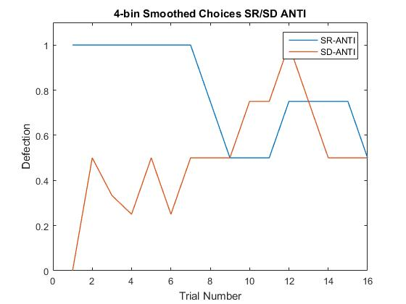
Individual Participant Choices – Smoothed 104

Slide 11
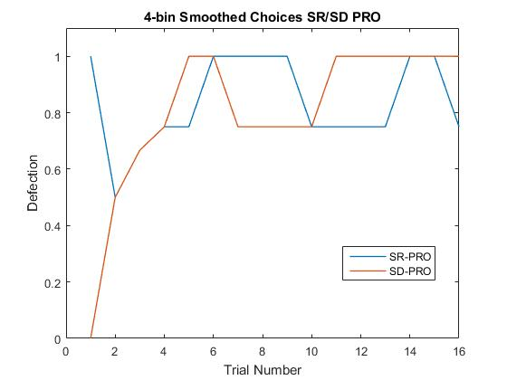
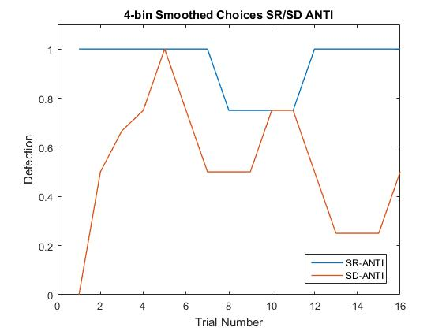
Individual Participant Choices – Smoothed 105

Slide 12
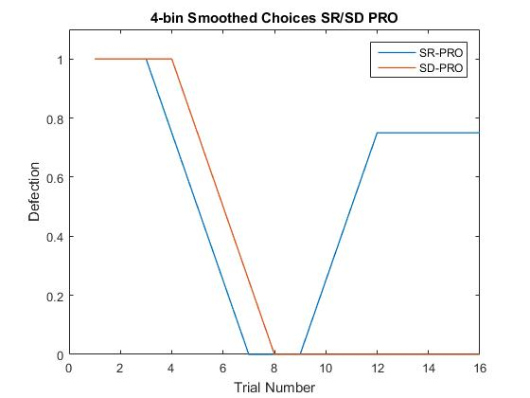
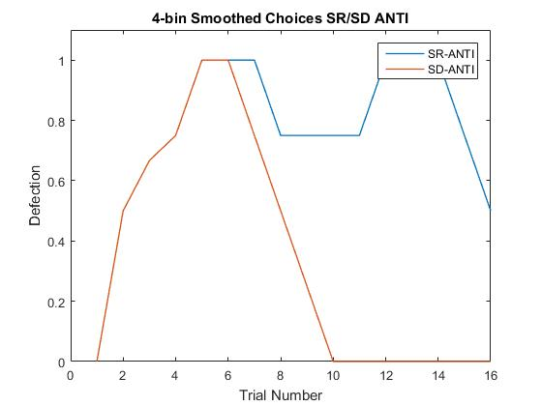
Individual Participant Choices – Smoothed 106

Slide 13
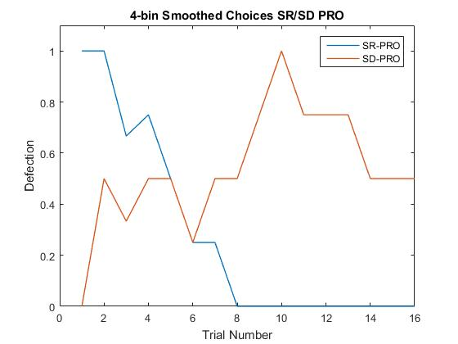
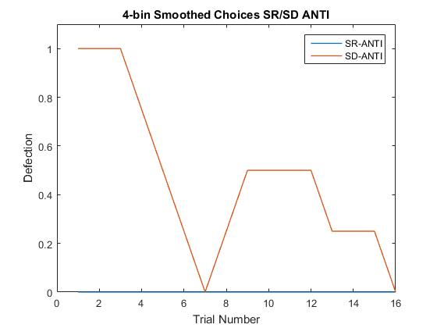
Individual Participant Choices – Smoothed 107

Slide 14
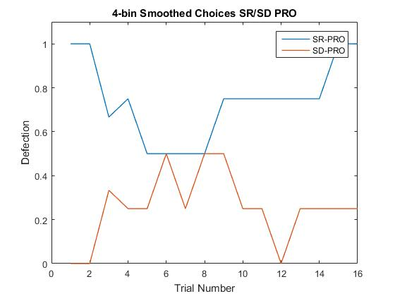
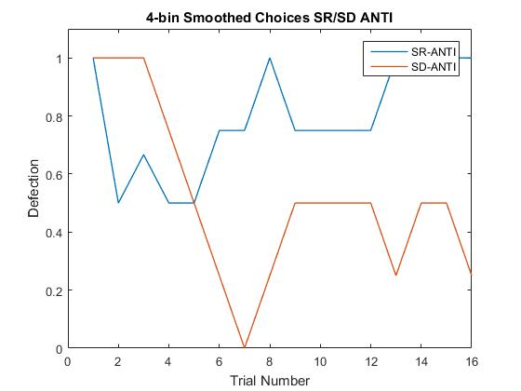
Individual Participant Choices – Smoothed 108

Slide 15
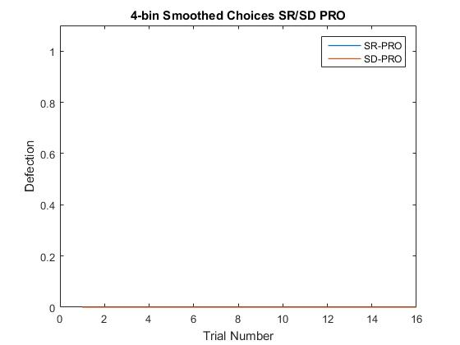
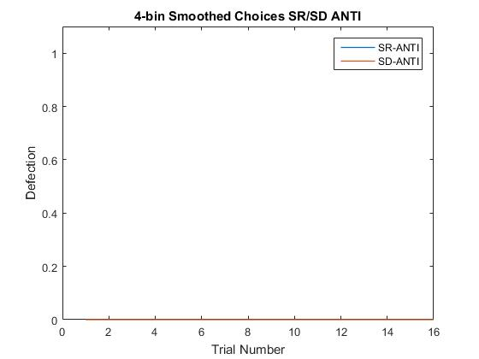
Individual Participant Choices – Smoothed 109
Only Cooperated, all conditions

Slide 16
Individual Participant Choices – Smoothed 110
Only Cooperated, all conditions

Slide 17
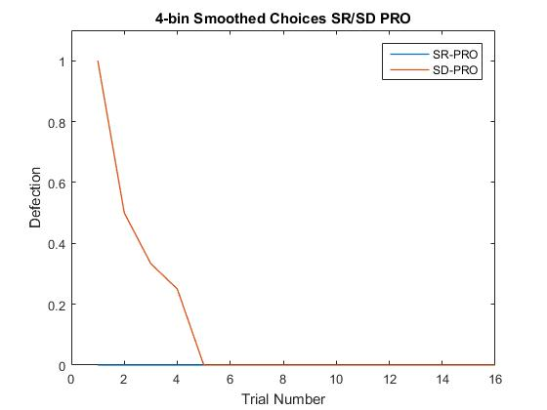
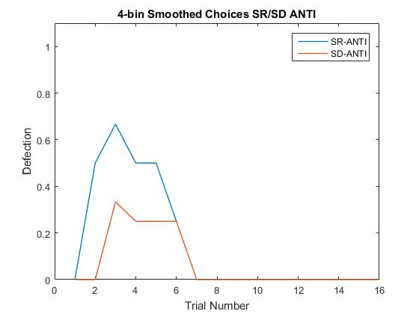
Individual Participant Choices – Smoothed 112
Only Cooperated, SR PRO

Slide 18
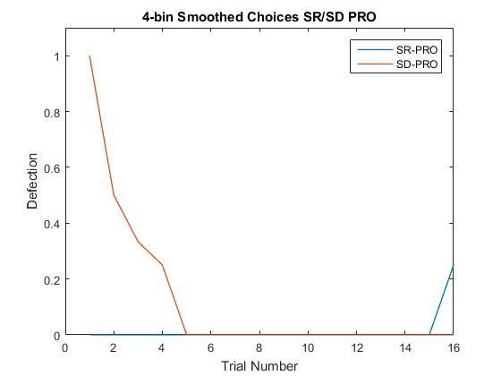
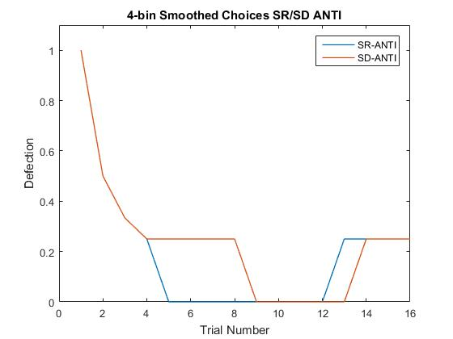
Individual Participant Choices – Smoothed 113

Slide 19
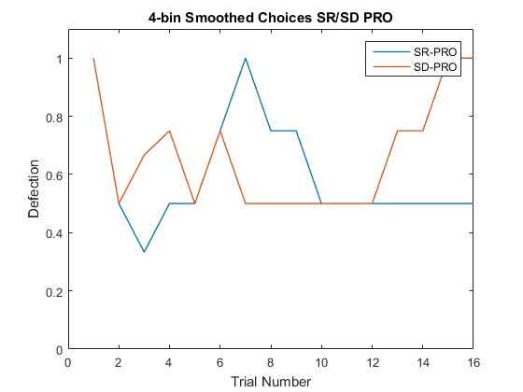
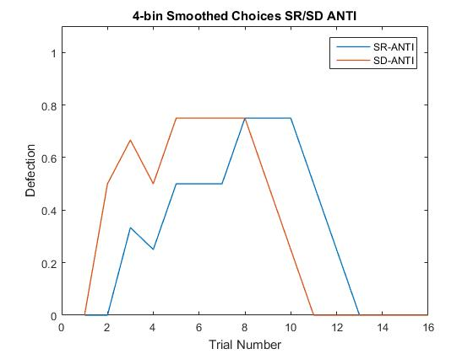
Individual Participant Choices – Smoothed 114

Slide 20
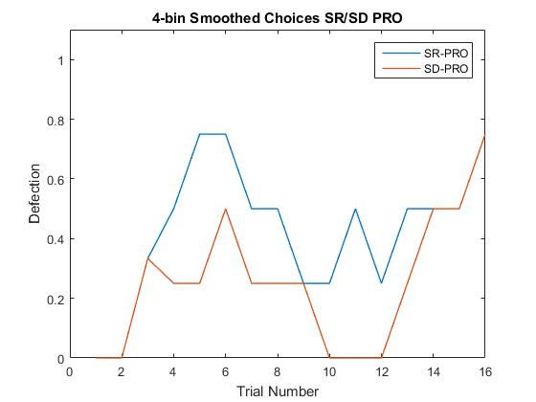
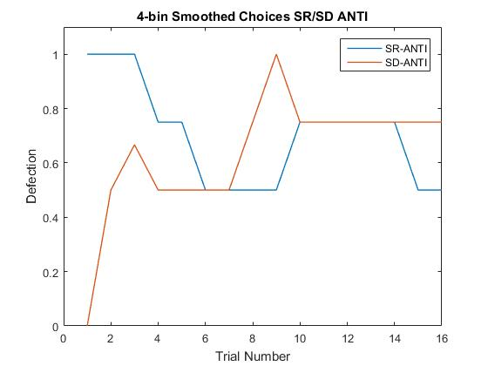
Individual Participant Choices – Smoothed 115

Slide 21
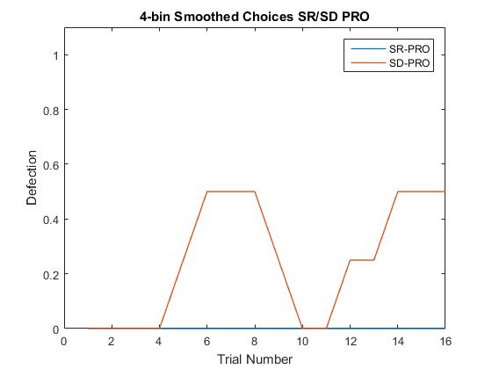
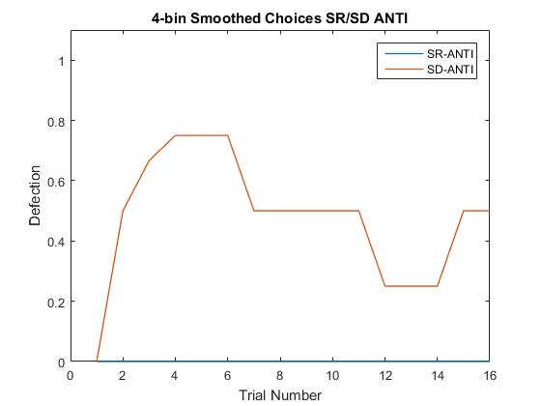
Individual Participant Choices – Smoothed 116
Only Cooperated, SR ANTI
Only Cooperated, SR PRO

Slide 22
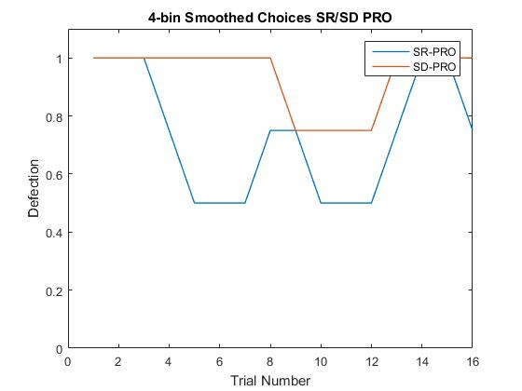
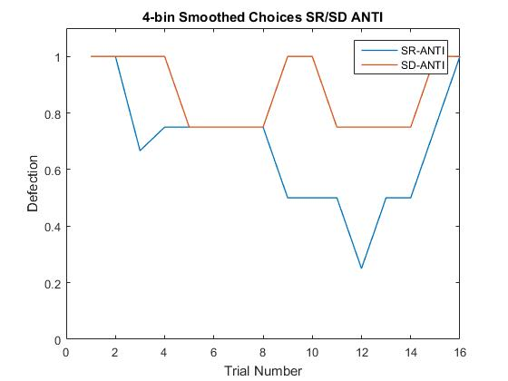
Individual Participant Choices – Smoothed 117

Slide 23
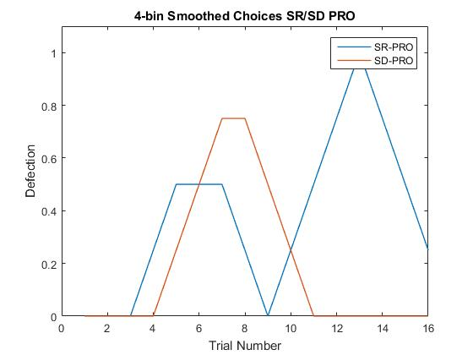
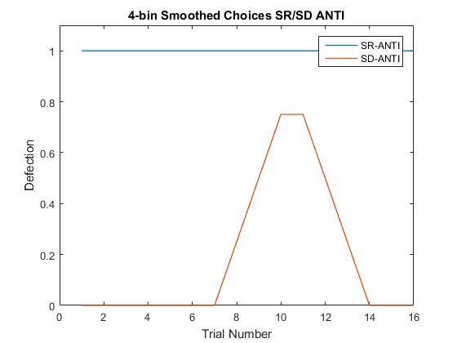
Individual Participant Choices – Smoothed 118
Only Defected SR ANTI

Slide 24
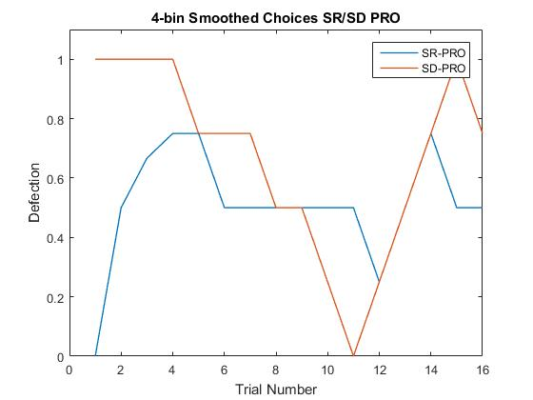
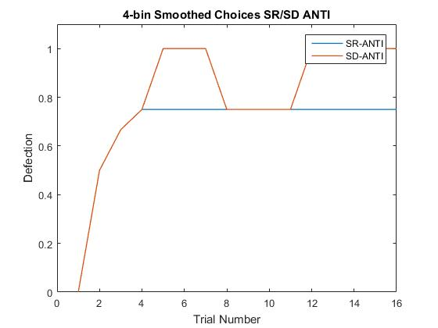
Individual Participant Choices – Smoothed 119

Slide 25
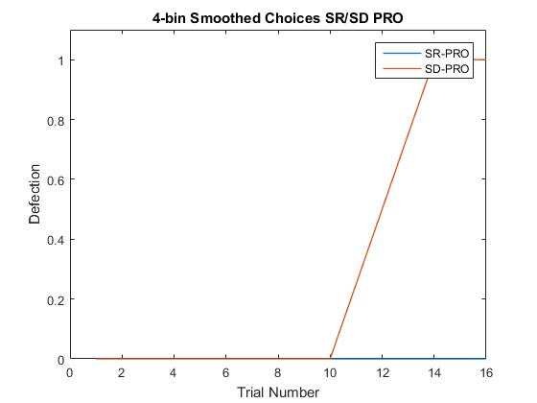
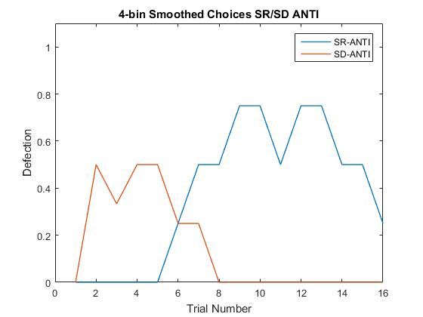
Individual Participant Choices – Smoothed 120
Only Cooperated SR PRO

Slide 26
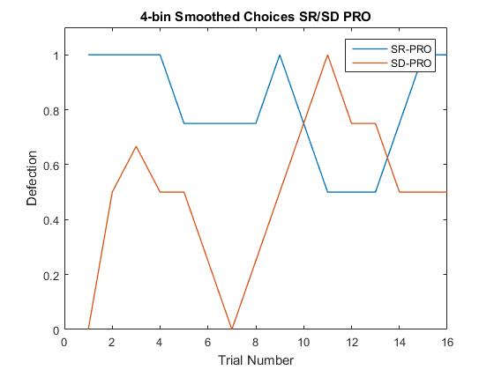
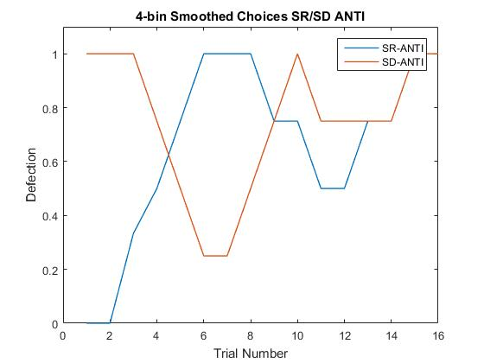
Individual Participant Choices – Smoothed 121

Slide 27
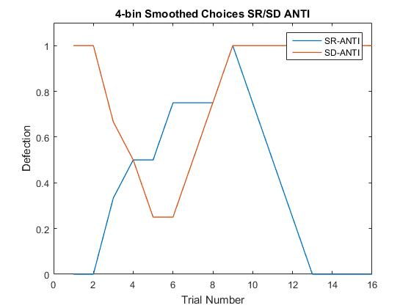
Individual Participant Choices – Smoothed 122
Only Cooperated SD/SR PRO

Slide 28
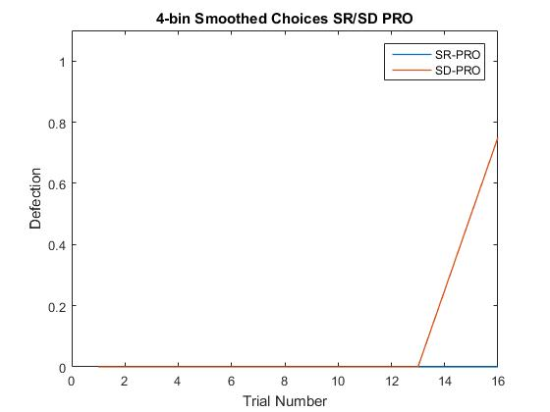
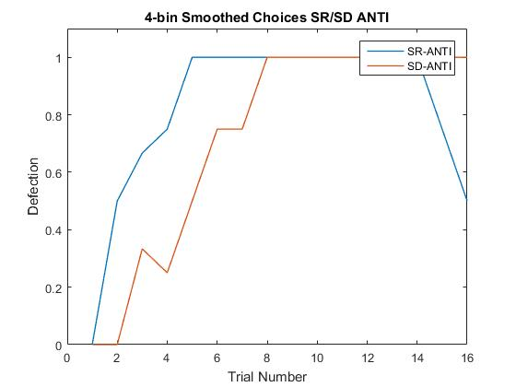
Individual Participant Choices – Smoothed 123
Only Cooperated SR PRO

Slide 29
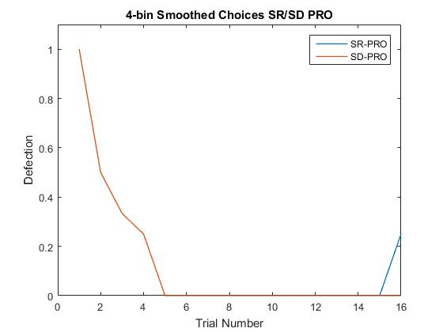
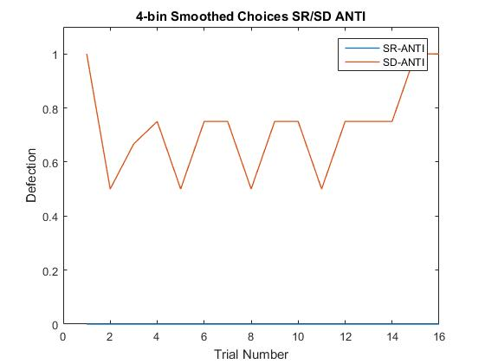
Individual Participant Choices – Smoothed 124
SR/SD PRO same until final round
Only Cooperated SR ANTI

Slide 30
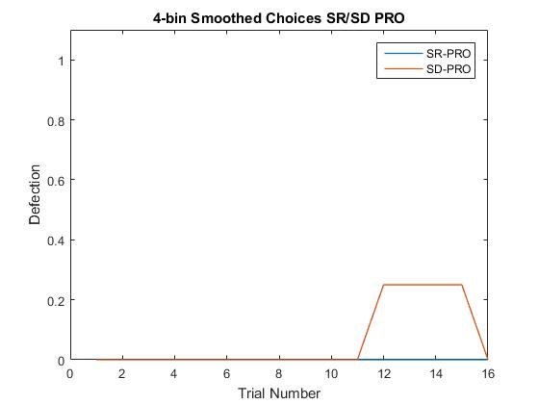

Individual Participant Choices – Smoothed 125
Only Cooperated in SR PRO/ANTI

Slide 31

Individual Participant Choices – Smoothed 126
Only Cooperated SR PRO

Slide 32


Individual Participant Choices – Smoothed 128

